Slide 1
Chapter 8
Information Security

Slide 2
Learning Objectives (1 of 2)
Explain the difference between authentication and authorization
Explain the use of a hash function to encrypt passwords on a computer system
Describe cyber-attacks including viruses, worms, Trojan horses, DoS attacks, and phishing, and explain how they differ from each other
Describe ways to increase the security of information on your computer and online
Encrypt and decrypt messages using simple Caesar ciphers and matrix-based block ciphers

Slide 3
Learning Objectives (2 of 2)
Describe the overall process used by symmetric encryption algorithms such as DES
Describe the overall process used by RSA public-key encryption
Explain why web transmission protocols such as SSL and TLS use multiple forms of encryption to secure data transfer over the web
Explain the importance of computer security for networked embedded systems

Slide 4
Introduction
Information security
Keep information safe
Control access to authorized people only
Physical security
lock doors
maintain control of devices
Online security
Secure assembly language
Secure operating system
Secure network

Slide 5
Threats and Defenses
Threats online are often more dangerous than threats to physical items
Hackers prefer to attack easily accessible data
Multiple deterrents to online attacks

Slide 6
Threats and Defenses Authentication and Authorization (1 of 8)
Authentication: establishing identity
Require usernames and passwords
Secure a password file with a hash function; one-way encryption
Example: password = badboy2
Replace letters by numbers: 2 1 4 2 15 25 2
Add digits: 2 + 1 + 4 + 2 + 15 + 25 + 2 = 51
Remainder of sum/7: 51 mod 7 = 2
Add 1 and multiply by 9: (2 + 1) × 9 = 27
Reverse digits and convert to letters: 72 = gb

Slide 7
Threats and Defenses Authentication and Authorization (2 of 8)
Password file security: no plaintext password stored
On login
Read username and password
Look up entry for username in a password file
Hash input password and compare
More secure method
Keep password creation time
Add creation time to password before hashing
Identical passwords won’t hash to identical values

Slide 8
Threats and Defenses Authentication and Authorization (3 of 8)
Password attacks
Guess password, brute force or from knowledge
Try common passwords (e.g,123456)
Try personal references (e.g., pet name)
Try all possible passwords (computationally difficult)
Steal password file and use password-cracking software
Tries words and word combinations, millions of password possibilities per second
Social engineering: get a person to tell password

Slide 9
Threats and Defenses Authentication and Authorization (4 of 8)
Other authentication methods
Answer personal information question
Biometric information (fingerprint or retinal scans)
One-time password scheme
User enters ID and a partial password
System or user device generates last half of the password
Last half of the password is good for only a few seconds
Dual authentication: Temporary code or password is sent to a trusted device

Slide 10
Threats and Defenses Authentication and Authorization (5 of 8)
Authorization: set of permitted actions for each authorized person
Operating system maintains access control lists
Read access (read a file)
Write access (modify a file)
Execute access (run a program)
Delete access (remove a file)
System administrator or superuser has universal access and sets up authorization

Slide 11
Threats and Defenses Authentication and Authorization (6 of 8)
Malware: malicious software arriving from the network
Virus: program embedded within another program or file, replicates itself and attacks other files
Worm: program that can send copies of itself to other nodes on the network
Trojan horse: program that seems beneficial but hides malicious code within it
Keystroke logger: records all keys typed
Drive-by exploit/drive-by download: Trojan horse downloaded by simply visiting an infected website

Slide 12
Threats and Defenses Authentication and Authorization (7 of 8)
Denial-of-service (DoS) attack: many computers try to access the same URL at the same time
Clogs the network, prevents legitimate access, and causes the server to crash
Distributed DoS uses thousands of computers
Uses a zombie army (botnet): many innocent computers infected with malware
Phishing: obtain sensitive information by impersonating legitimate sources
Many emails; just a few “bites” are enough

Slide 13
Threats and Defenses Authentication and Authorization (8 of 8)
White hats are security experts and those who work to help protect systems from attackers.
Black hats are individuals or groups who work toward getting around security to steal information, get money, or do other nefarious, immoral, and illegal acts.

Slide 14
Encryption Overview
Cryptography: science of “secret writing”
Encryption and decryption (inverse operations)
Convert from plaintext to ciphertext and back again
Symmetric encryption algorithm
A secret key shared by the sender and the receiver
Same key is used to encrypt and decrypt
Asymmetric encryption algorithm (public key)
Uses two keys: public and private
Use public key (generally known) to encrypt
Use private key (known only to receiver) to decrypt

Slide 15
Encryption Simple Encryption Algorithms (1 of 5)
Caesar cipher (shift cipher)
Map characters to others a fixed distance away in the alphabet
Example: A→E, B→F, C→G…U→Y, V→Z, W→A
Stream cipher: encode each character as it comes
Substitution cipher: similar, but implement other mappings
Pros: easy and fast, can do character by character
Cons: letter frequency, double letters, still pertain, make it easy to break

Slide 16
Encryption Simple Encryption Algorithms (2 of 5)
Block cipher
Block of plaintext encoded into a block of ciphertext
Each character contributes to multiple characters
Matrix-based block cipher
Group characters into blocks n characters long
Find invertible n by n matrix, M, and its inverse, M′ as keys
Map characters to letters A→1, B→2, etc.
Wrap values 26 and above back to zero: 26→0, 27→1, etc.

Slide 17
Encryption Simple Encryption Algorithms (3 of 5)
FIGURE 8.1
Encoding
Apply S mapping to plaintext block.
Multiply result times M, applying wraparound.
Apply S’ to the result.
Decoding
Apply S mapping to ciphertext block.
Multiply result times M’, applying wraparound.
Apply S’ to the result.
Steps in encoding and decoding for a block cipher.

Slide 18
Encryption Simple Encryption Algorithms (4 of 5)
Example: use 2 by 2 matrices:

Slide 19
Encryption Simple Encryption Algorithms (5 of 5)
Example: use 2 by 2 matrices:

Slide 20
Encryption (DES) Data Encryption Standard (1 of 3)
Symmetric encryption algorithm
Designed for digital data; plaintext is a binary string
Uses 64-bit binary key (56 bits actually used)
Sixteen rounds of the same series of manipulations
Decryption uses the same algorithm; keys in reverse
Fast and effective but requires shared key
56 bits is too small for modern technology
AES (Advanced Encryption Standard) uses a similar approach; longer keys

Slide 21
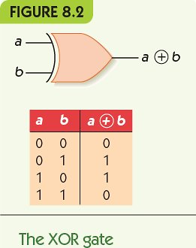
Encryption (DES) Data Encryption Standard (2 of 3)
DES manipulations
Split string
Duplicating some bits
Omit some bits
Permute bit order
Combine bit strings with XOR (exclusive OR)

Slide 22
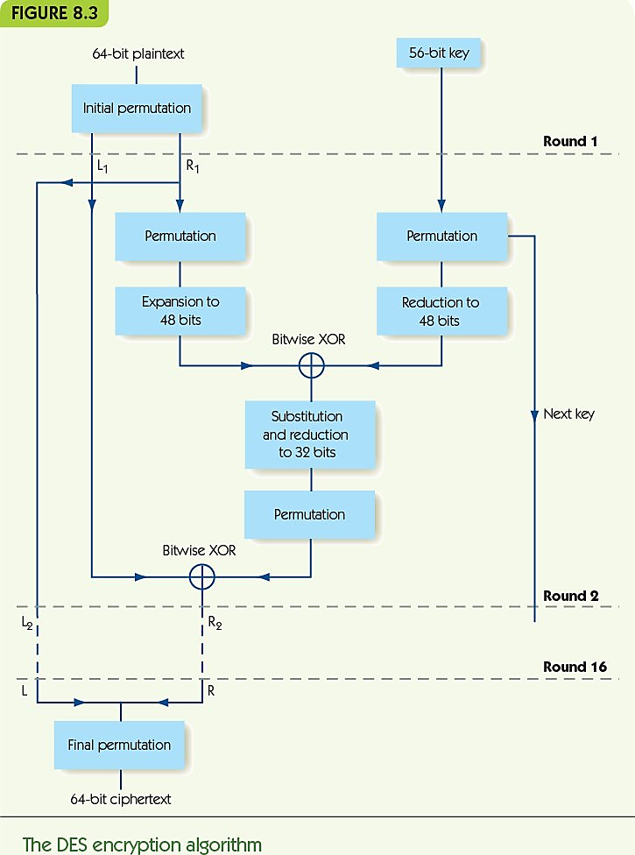
Encryption (DES) Data Encryption Standard (3 of 3)

Slide 23
Encryption Public-Key Systems (1 of 4)
RSA key creation
Pick 2 large prime numbers: p and q
Compute n = p× q, and m = (p - 1)× (q - 1)
Choose large number e at random so that e and m are relatively prime (no common factors except 1)
Find unique value d, between 0 and m, such that
(e × d) modulo m = 1
Public key = (n, e); Private key = d

Slide 24
Encryption Public-Key Systems (2 of 4)
RSA key creation, example
p = 7, q = 13
n = 7 × 13 = 91, and m = 6 × 12 = 72
Let e = 77 (72 = 2 * 2 * 2 * 3 * 3, 77 = 7 * 11)
d = 29
Public key = (91, 25); Private key = 29

Slide 25
Encryption Public-Key Systems (3 of 4)
RSA encryption
Given public key (n, e)
Convert message to integer P
Calculate C = P^{e} modulo n
RSA decryption
Given private key d
Calculate C^{d} modulo n

Slide 26
Encryption Public-Key Systems (4 of 4)
RSA encryption, example
Given public key (91, 25)
Convert message to integer P = 37
Calculate C = 37²⁵ modulo 91 = 46
RSA decryption
Given private key 29
Calculate 46²⁹ modulo 91 = 37

Slide 27
Web Transmission Security (1 of 2)
Ecommerce requires secure transmission of names, passwords, and credit card numbers
Web protocols: SSL (Secure Sockets Layer) and TLS (Transport Layer Security)
Client-server applications
Server provides certificate of authentication and server’s public key
Client sends its DES key, encrypted using RSA
Data is sent encrypted by the (now shared) DES key

Slide 28
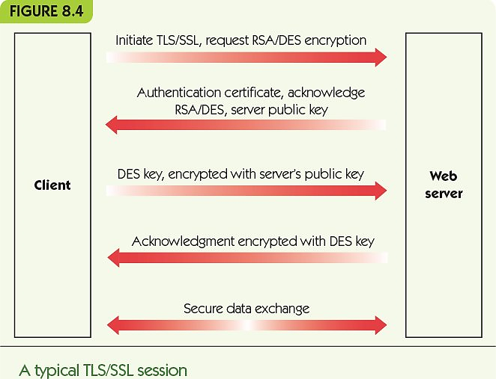
Web Transmission Security (2 of 2)

Slide 29
Embedded Computing
Embedded computers: special-purpose, limited computers in other systems
Examples: automobiles, smart appliances, remote controls, and patient monitoring systems
New trend: connect embedded computers to a network
Transmit data, receive updates
Targeting embedded systems could cause chaos
Change thermostats, disrupt patient care, or disable aircraft or automobiles

Slide 30
Summary (1 of 2)
Internet and web are meant to promote information exchange, so information security is hard.
Online attacks include viruses, worms, Trojan horses, DoS attacks, and phishing, among others.
Data security involves encrypting sensitive data before transmitting or storing in unsecured location.
Symmetric encryption requires a shared key.
Asymmetric encryption uses public and private keys.

Slide 31
Summary (2 of 2)
Caesar cipher is a simple symmetric encryption; substitution ciphers are similar.
Block ciphers combine blocks of plaintext symbols into blocks of ciphertext.
DES and AES are strong symmetric encryption algorithms.
RSA is the most common asymmetric algorithm.
Secure web transmission requires protocols: SSL/TLS.
Embedded systems are the next problem to solve.

